Slide 1

Startup Insights Report
An analysis of startups' funding, industry, and market trends
By Rupnath Shaw

Slide 2
Dataset Overview
The StartupDB dataset contains information about various startups, including:
Company Details: Name, industry, founding year, headquarters.
Financials: Funding stage, last funding amount.
Operations: Number of employees, market size, core technology.
Leadership & Contact: CEO, website, LinkedIn, Twitter.
Sample Size: Multiple startups across industries and regions.
Problem Statement
Analyze the startup ecosystem to uncover key insights such as:
Industries attracting the most funding.
High-growth startups based on employee count and funding.
Locations and CEOs driving startup success.
Market potential relative to funding and emerging technologies.

Slide 3
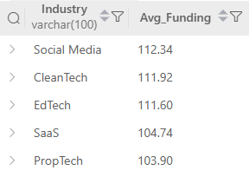
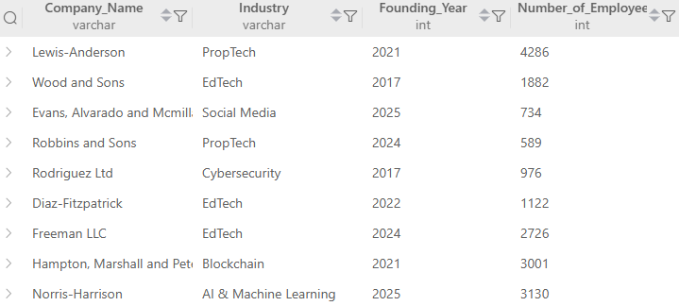
-- Q1. Find the top 5 industries with the highest average funding amount, excluding startups with NULL funding values.
SELECT
Industry,
ROUND(AVG(Last_Funding_Amount_USD_Millions),2) AS Avg_Funding
FROM Startups
WHERE Last_Funding_Amount_USD_Millions IS NOT NULL
GROUP BY Industry
ORDER BY Avg_Funding DESC
LIMIT 5;
Output →
-- Q2. List the startups founded after 2015 that have more employees than the average number of employees across all
startups.
SELECT Company_Name, Industry, Founding_Year, Number_of_Employees
FROM Startups
WHERE Founding_Year > 2015
AND Number_of_Employees > (
SELECT AVG(Number_of_Employees)
FROM Startups
WHERE Number_of_Employees IS NOT NULL
);
Output →

Slide 4
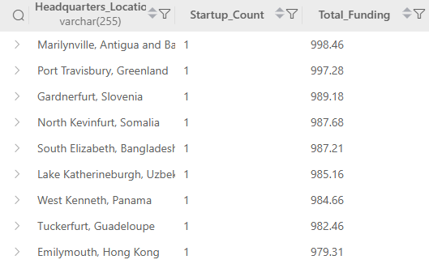
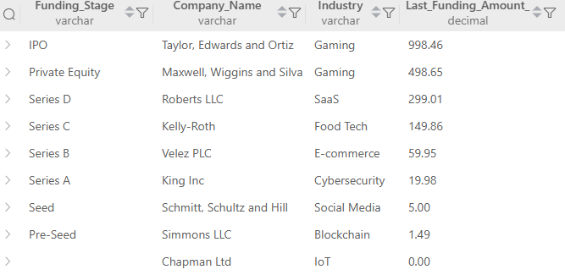
-- Q3. Identify the headquarters locations that host at least 1 startups, and calculate the total funding raised in each.
SELECT Headquarters_Location,
COUNT(*) AS Startup_Count,
SUM(Last_Funding_Amount_USD_Millions) AS Total_Funding
FROM Startups
WHERE Last_Funding_Amount_USD_Millions IS NOT NULL
GROUP BY Headquarters_Location
HAVING COUNT(*) >= 1
ORDER BY Total_Funding DESC;
Output →
-- Q4. For each funding stage, find the startup with the maximum funding amount and display its company name, industry,
and funding.
WITH RankedStartups AS (
SELECT Funding_Stage, Company_Name, Industry,
Last_Funding_Amount_USD_Millions,
ROW_NUMBER() OVER (PARTITION BY Funding_Stage ORDER BY Last_Funding_Amount_USD_Millions DESC) AS rn
FROM startups
WHERE Last_Funding_Amount_USD_Millions IS NOT NULL)
SELECT Funding_Stage, Company_Name, Industry, Last_Funding_Amount_USD_Millions
FROM RankedStartups
WHERE rn = 1
ORDER BY Last_Funding_Amount_USD_Millions DESC;
Output →

Slide 5
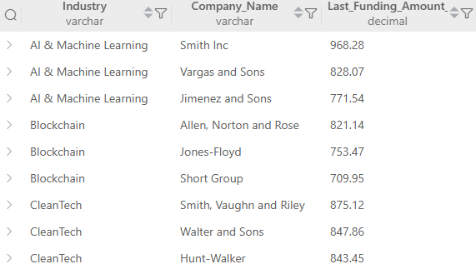
-- Q5. Rank startups within each industry by their funding amount and select only the top 3 per industry.
WITH RankedStartups AS (
SELECT
Company_Name,
Industry,
Last_Funding_Amount_USD_Millions,
ROW_NUMBER() OVER (
PARTITION BY
Industry
ORDER BY
Last_Funding_Amount_USD_Millions DESC
) AS rn
FROM startups
WHERE
Last_Funding_Amount_USD_Millions IS NOT NULL
)
SELECT Industry, Company_Name, Last_Funding_Amount_USD_Millions
FROM RankedStartups
WHERE rn <= 3
ORDER BY
Industry,
Last_Funding_Amount_USD_Millions DESC;
Output →

Slide 6
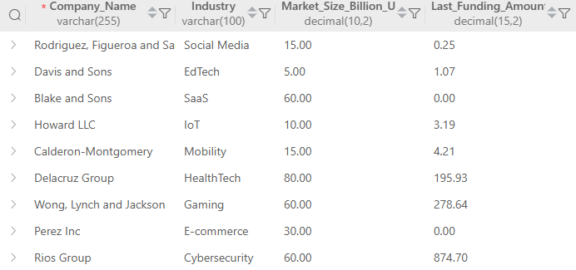
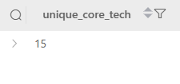
-- Q6. Find all startups where the market size (in billion USD) is more than 3 times their last funding amount
(in million USD).
SELECT Company_Name, Industry,
Market_Size_Billion_USD,
Last_Funding_Amount_USD_Millions
FROM startups
WHERE
Market_Size_Billion_USD IS NOT NULL
AND Last_Funding_Amount_USD_Millions IS NOT NULL
AND Market_Size_Billion_USD * 1000 > 3 * Last_Funding_Amount_USD_Millions;
Output →
-- Q7. Count how many unique core technologies are being used by startups in the "FinTech" industry.
SELECT COUNT(DISTINCT Core_Technology) AS unique_core_tech
FROM startups
WHERE
Industry = 'FinTech';
Output →

Slide 7
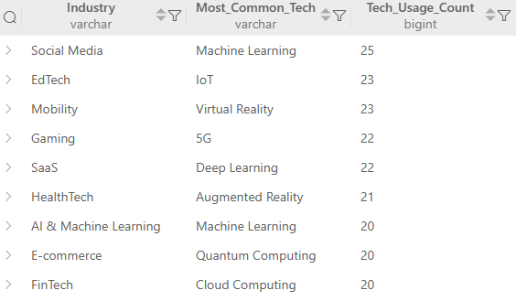
-- Q8. Find the most common core technology used in each industry
WITH TechCount AS (
SELECT
Industry,
Core_Technology,
COUNT(*) AS Tech_Usage_Count,
ROW_NUMBER() OVER (
PARTITION BY Industry
ORDER BY COUNT(*) DESC
) AS rn
FROM
Startups
WHERE
Core_Technology IS NOT NULL
GROUP BY
Industry, Core_Technology
)
SELECT Industry, Core_Technology AS Most_Common_Tech,
Tech_Usage_Count
FROM TechCount
WHERE rn = 1
ORDER BY Tech_Usage_Count DESC;
Output →

Slide 8
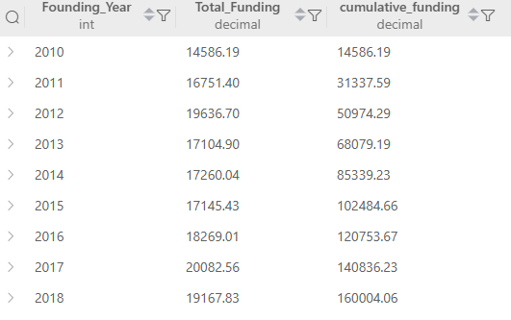
-- Q9. For each year between 2010 and 2020, calculate the cumulative total funding received by all startups founded
in that year.
WITH
YearlyFunding AS (
SELECT Founding_Year, SUM(
Last_Funding_Amount_USD_Millions
) AS Total_Funding
FROM startups
WHERE
Founding_Year BETWEEN 2010 AND 2020
GROUP BY
Founding_Year
)
SELECT
Founding_Year,
Total_Funding,
SUM(Total_Funding) OVER (
ORDER BY
Founding_Year ROWS BETWEEN UNBOUNDED PRECEDING
AND CURRENT ROW
) AS cumulative_funding
FROM YearlyFunding;
Output →

Slide 9
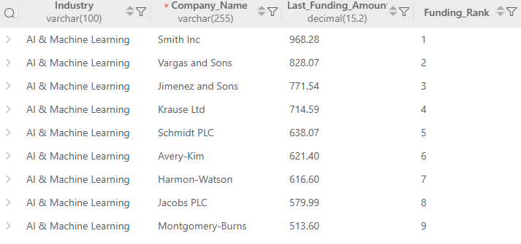
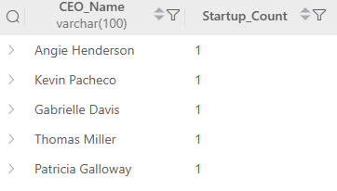
-- Q10. Rank startups within each industry based on their last funding amount
SELECT
Industry,
Company_Name,
Last_Funding_Amount_USD_Millions,
RANK() OVER (
PARTITION BY Industry
ORDER BY Last_Funding_Amount_USD_Millions DESC
) AS Funding_Rank
FROM Startups
WHERE Last_Funding_Amount_USD_Millions IS NOT NULL
ORDER BY
Industry, Funding_Rank;
Output →
-- Q11. Find the CEOs who lead more than one startup and list all their associated company names.
SELECT CEO_Name,
COUNT(*) AS Startup_Count
FROM startups
GROUP BY
CEO_Name;
Output →

Slide 10

Strategic Recommendation
- FinTech, HealthTech, and AI-driven sectors are consistently outperforming in funding volume.
- Established startup hubs continue to attract a majority of total funding.
- Founders with cross-company leadership experience show strong investor trust.
- Startups surpassing their industry’s average funding could be prime acquisition or IPO candidates.
- Underfunded startups in large market spaces represent potential high-growth opportunities.

Slide 11
Thank you

